Slide 1
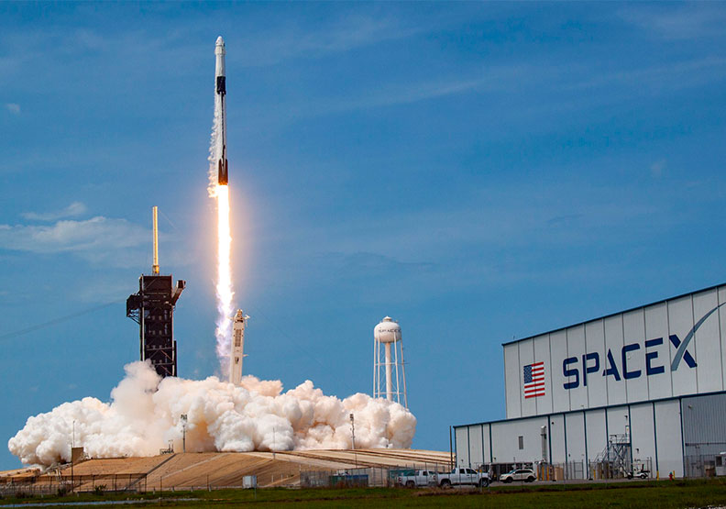
SpaceX Analysis Capstone Project
WeiKai Chao 2023/01/31

Slide 2
1
2
Executive Summary
Introduction
3
4
Methodology
Result
Outline
5
Conclusion

Slide 3
1
Executive Summary

Slide 4

Executive Summary
Data collection
Data preworking
EDA with data visualization
EDA with SQL
Building an interactive map with Folium
Buliding a dashboard with plotly dash
Predictive analysis

Slide 5
2
Introduction

Slide 6

Introduction
SpaceX is advertising flights on their Falcon 9 rocket for a cheaper price compared to other companies. This is due to their ability to reuse parts of the rocket, which helps them save money.

Slide 7
3
Methodology

Slide 8

Methodology
Data collection
Data wrangling
Data Visualiztion
Dashboard
Model methods

Slide 9

Web Scraping
Took a table about Falcon 9 launches from Wikipedia, changed it into a computer-readable format
Parse the table and convert it into a Pandas data frame

Slide 10

Data Wrangling
We will examine the data to discover patterns and decide what should be the target variable for training our machine learning models.
We will label successful landings as 1 and unsuccessful landings as 0.

Slide 11

EDA
This assignment is about predicting whether the first stage of the Falcon 9 rocket will land successfully.
SpaceX offers launches at a lower cost because they can reuse parts of the rocket.
We will examine the data and create useful features to help us make predictions.

Slide 12
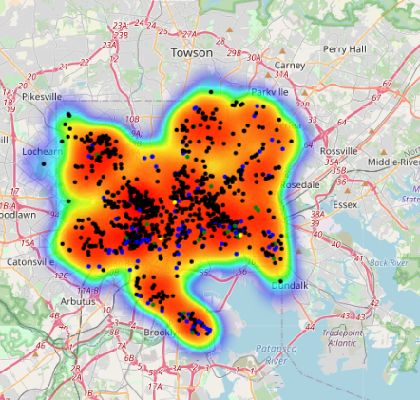
Analysis with Folium
we used matplotlib and seaborn to visualize the SpaceX launch dataset and found initial correlations between launch site and success rates.
This lab continues the analysis with Folium, a tool that allows for interactive visual analytics to gain deeper insights into the data and make more informed predictions.

Slide 13
4
Result

Slide 14
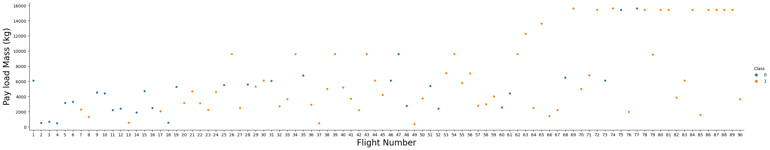
EDA Visualiztion
Plot out the FlightNumber vs. PayloadMass and overlay the outcome of the launch.

Slide 15
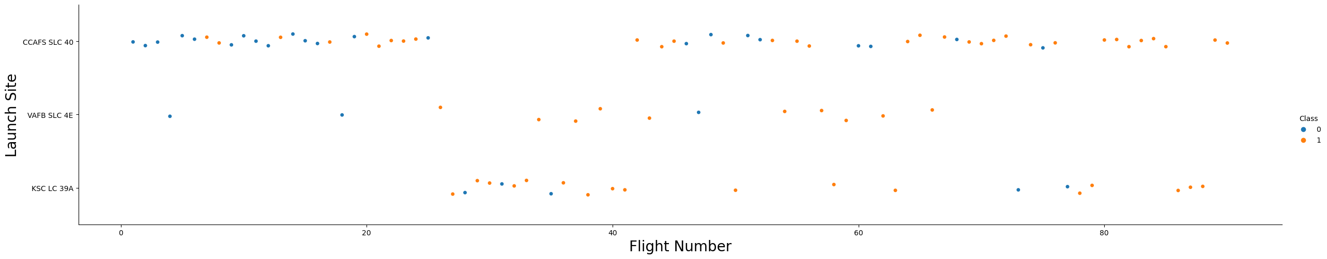
EDA Visualiztion
We will create a plot to see the relationship between the flight number and payload mass, and also show the outcome of each launch. As the flight number increases, the chance of a successful first stage landing increases. But as the payload mass grows, the likelihood of a successful landing decreases.

Slide 16
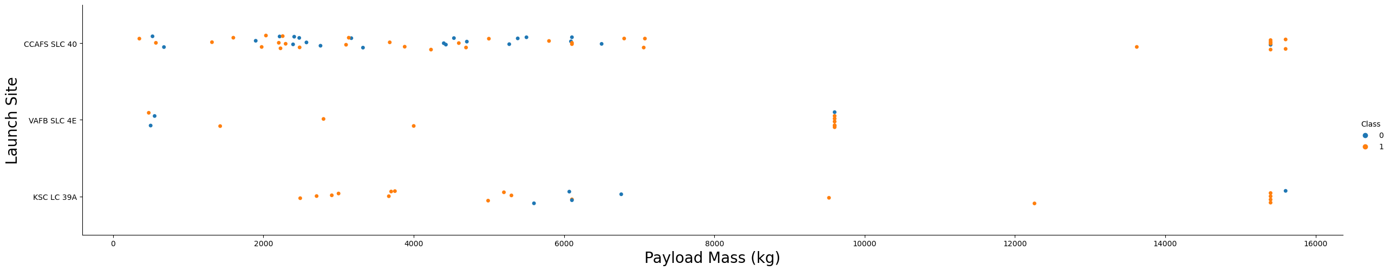
EDA Visualiztion
From the picture of Payload Vs. Launch Site scatter point chart find for the VAFB-SLC launchsite there are no rockets launched for heavypayload mass.

Slide 17
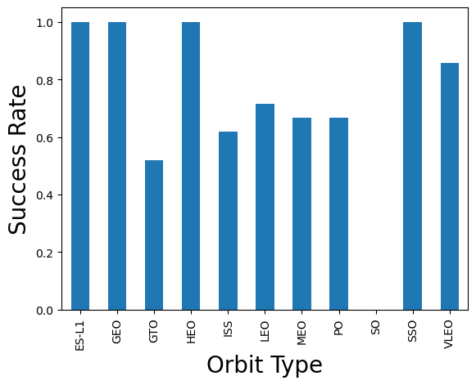
EDA Visualiztion
SO is the worst orbit. It even get the 0 success rate.
Over 80% orbits have more than 60% success rate. The result says the orbits did the incredible work.

Slide 18
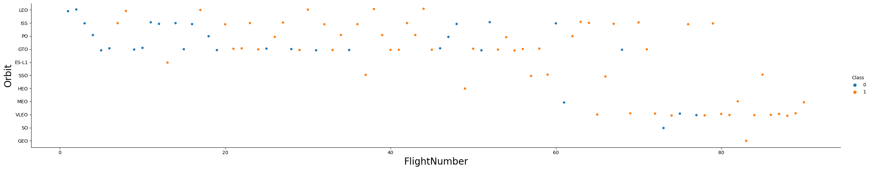
EDA Visualiztion
The LEO, ISS, PO, GTO orbits got relative low number. There are range between 0 to 60.
The SO orbit has the record between 60 to 100, and more calss 1.

Slide 19
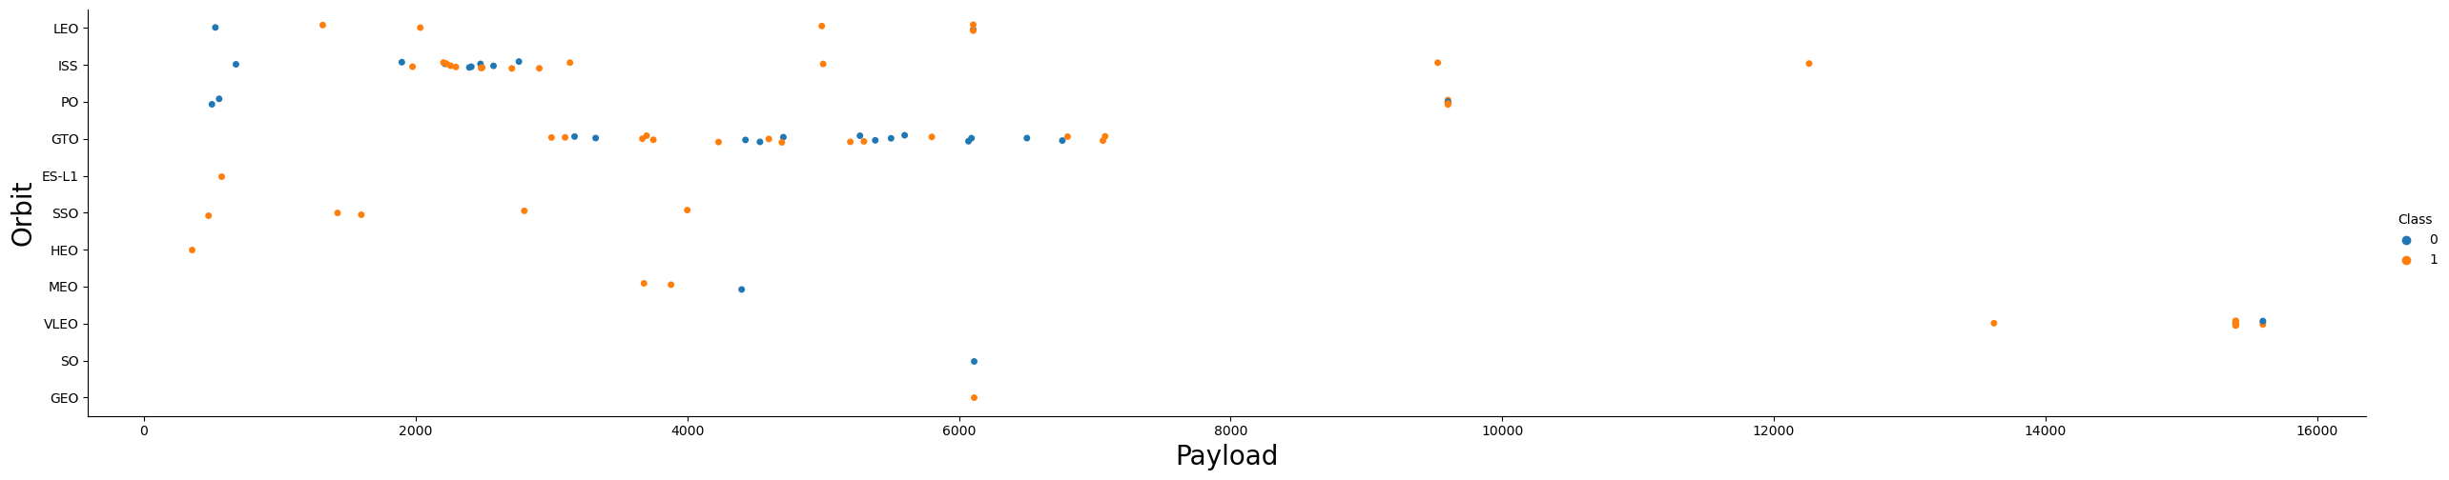
EDA Visualiztion
Failed landing rate is high for GTO (Geostationary Transfer Orbit) missions due to their high velocity and altitude.
This makes the landing more challenging and less predictable compared to Polar, LEO (Low Earth Orbit), and ISS (International Space Station) missions which have a lower velocity and altitude.

Slide 20
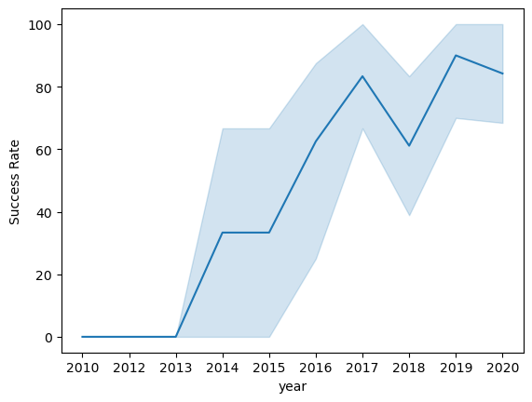
EDA Visualiztion
The success rate for launches has generally improved since 2013, with a slight dip in 2018
In recent years, the success rate has been around 80%.

Slide 21
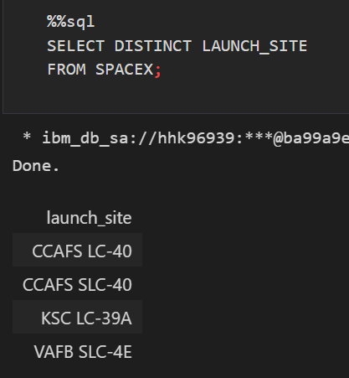
EDA with SQL

Slide 22
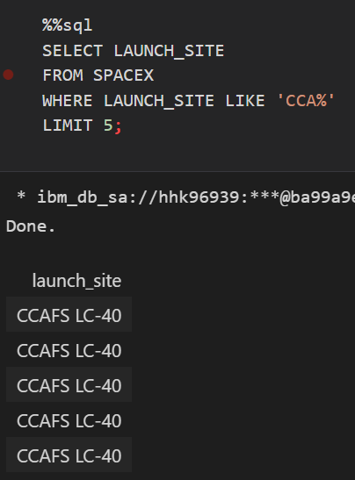
EDA with SQL

Slide 23
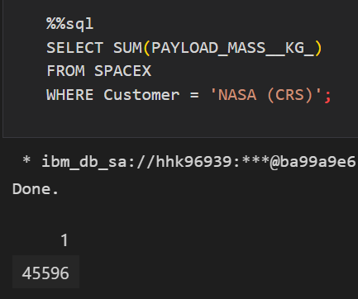
EDA with SQL

Slide 24
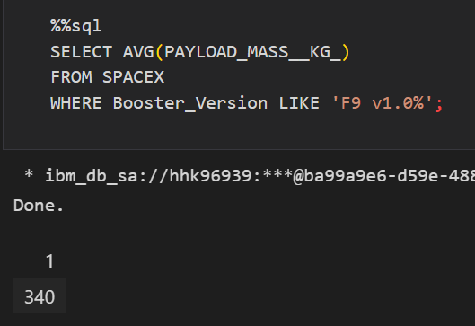
EDA with SQL

Slide 25
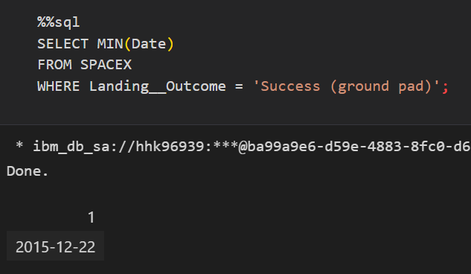
EDA with SQL

Slide 26
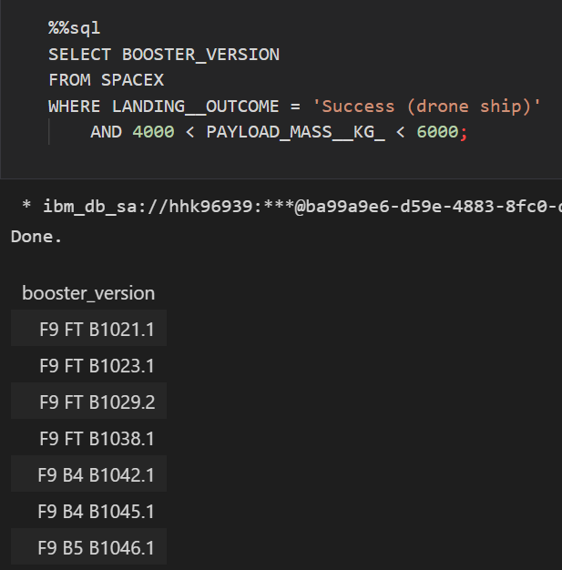
EDA with SQL

Slide 27
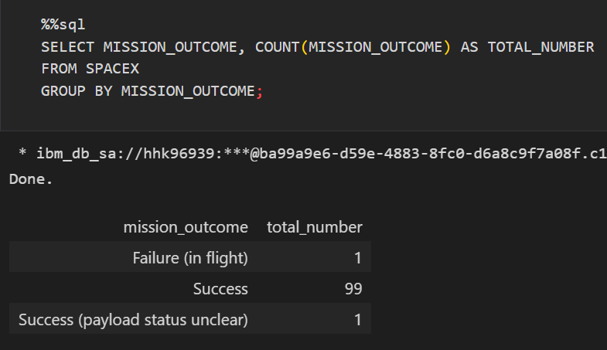
EDA with SQL

Slide 28
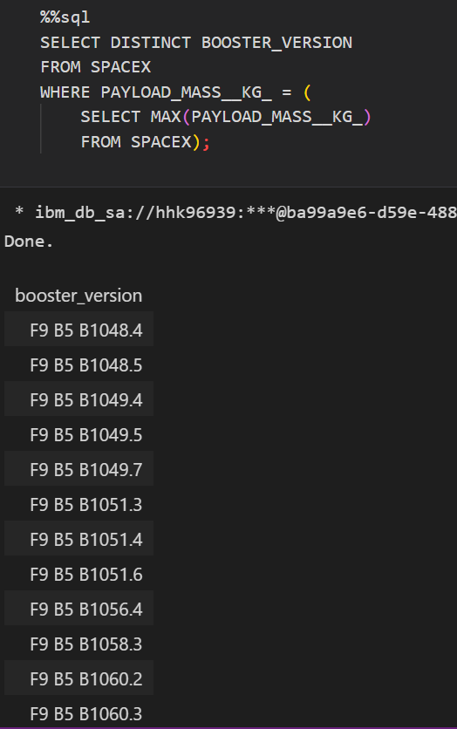
EDA with SQL

Slide 29
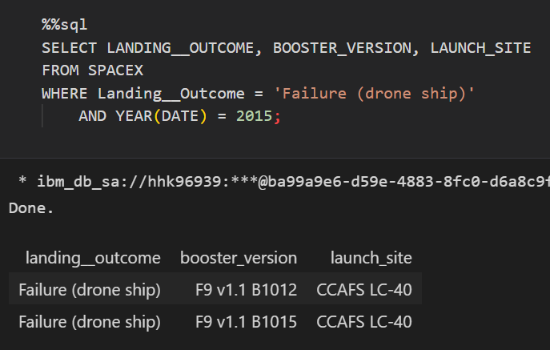
EDA with SQL

Slide 30
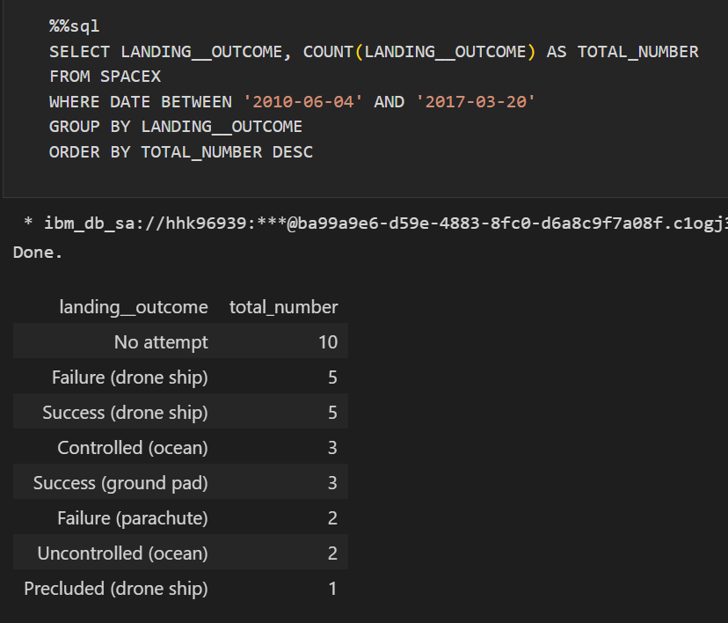
EDA with SQL

Slide 31
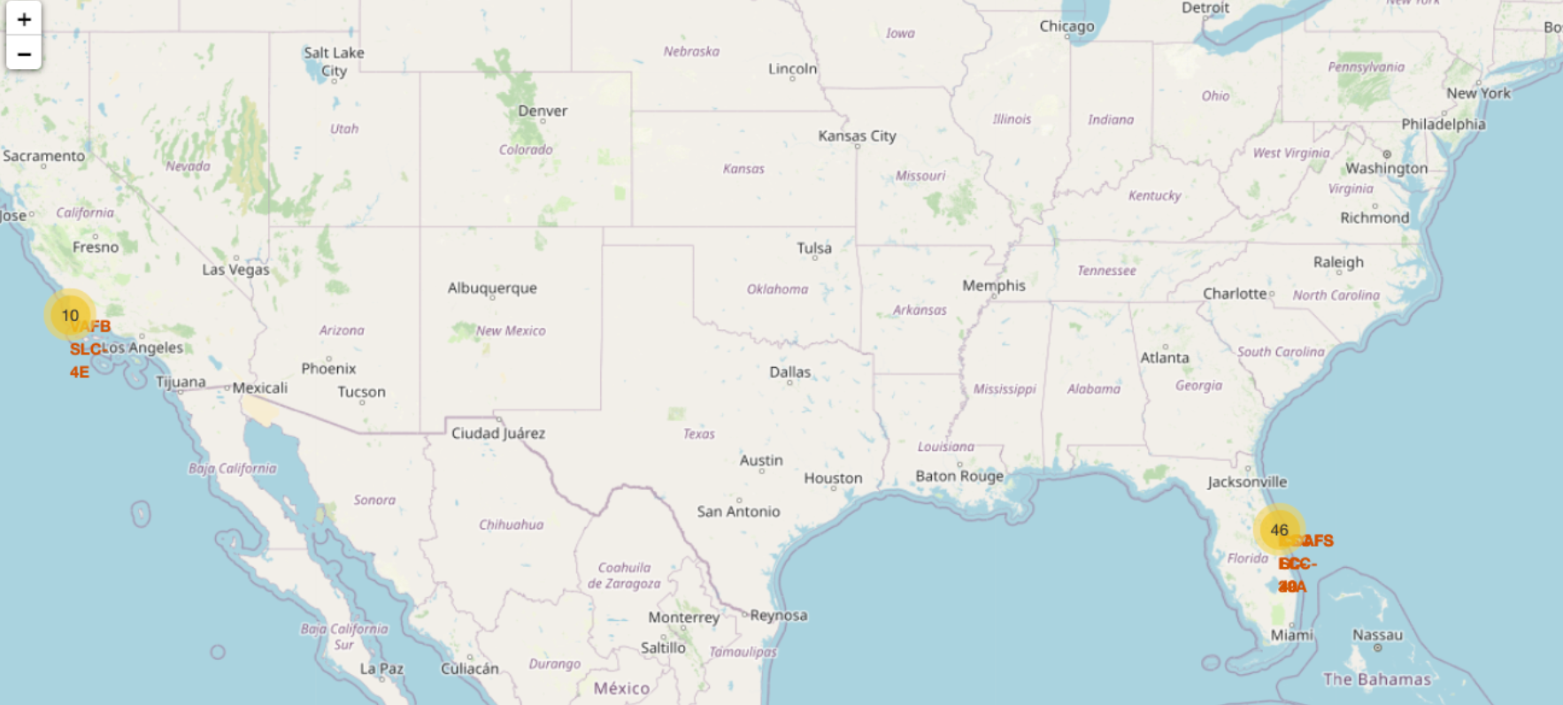
EDA with Folium

Slide 32
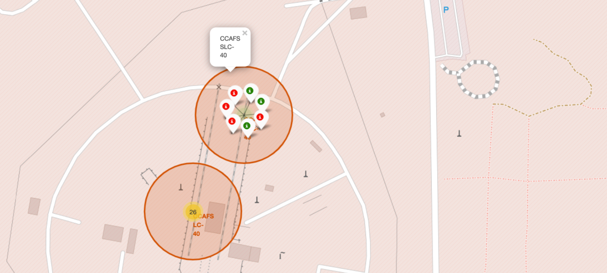
EDA with Folium

Slide 33

EDA with Folium
PolyLine between a launch site to the selected

Slide 34
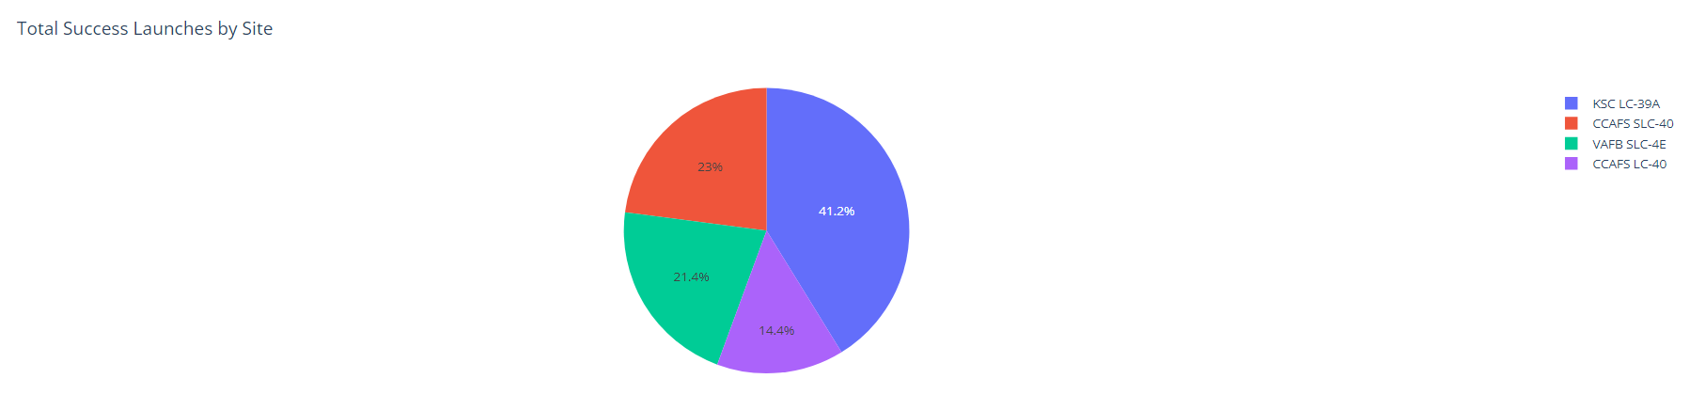
Dashboard with Plotly Dash
The KSC LC-39A has the most success launches in the four sites.
The last three sites have almost same part.

Slide 35
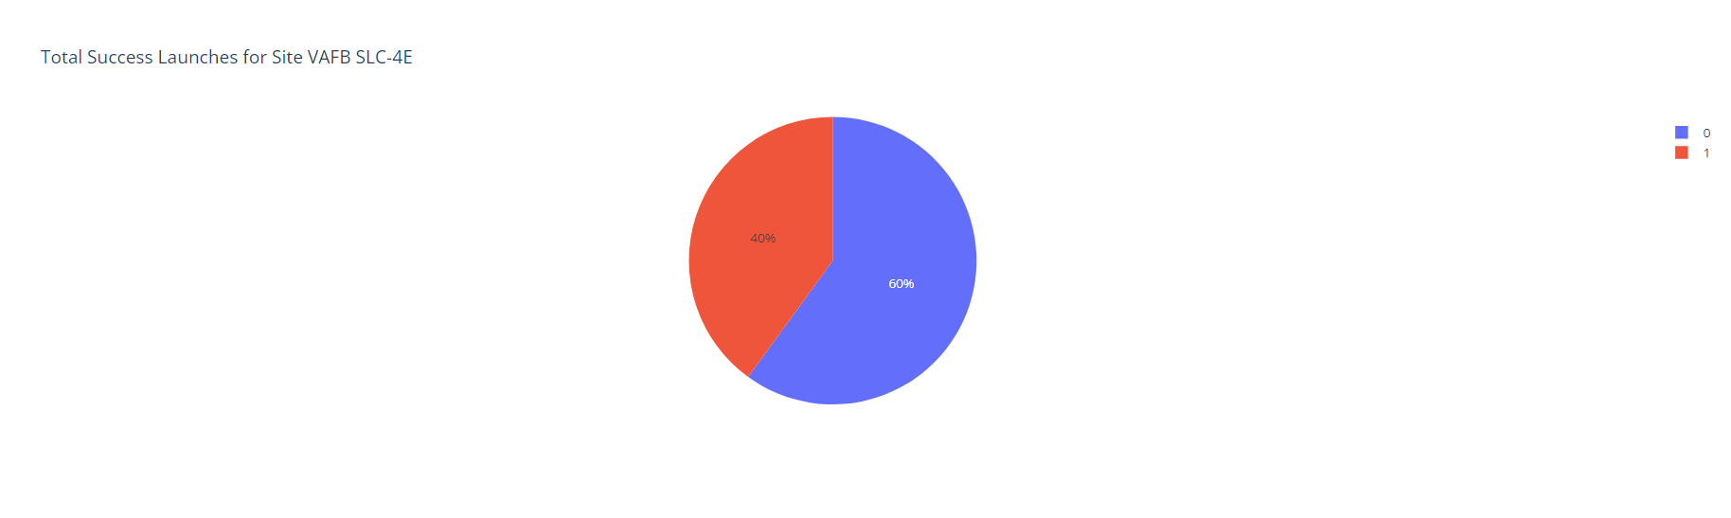
Dashboard with Plotly Dash
The class 0 is 60% in site VAFB SLC-4E. It is over the half of them.

Slide 36
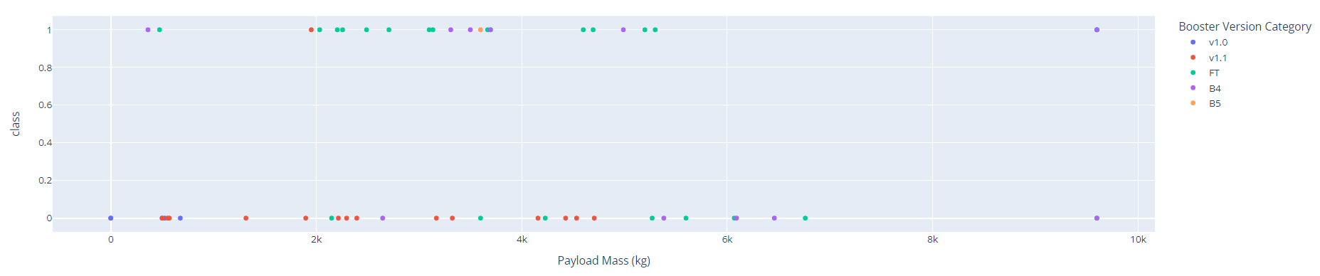
Dashboard with Plotly Dash
B4 has some of outlier.
V1.1 almost in the lower payload mass.

Slide 37
Dashboard with Plotly Dash
B4 has some of outlier.
V1.1 almost in the lower payload mass.

Slide 38
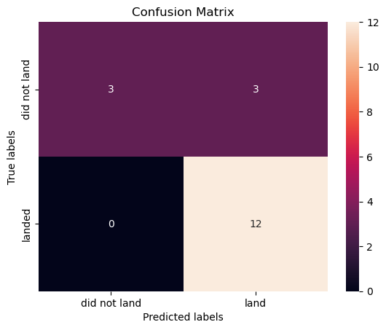
Machine Learning
Use SVM
The accuracy is 0.8333

Slide 39
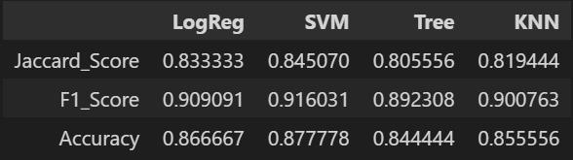
Machine Learning
F1_score is the good metrics to evaluate the model.
SVM is the best model, and then is the LogReg
SVM in the three metrics all the best model.

Slide 40
5
Conclusion

Slide 41

Machine Learning
We created a machine learning model to forecast successful Stage 1 landings for Space Y to compete with SpaceX.
Information was gathered from SpaceX Wikipedia and API, a dashboard was created for visualization, and data was entered into a SQL database.
Our model had 83% accuracy and can be used by Allon Mask of Space Y to make launch decisions. To improve accuracy, more data should be gathered and the optimum model should be selected.

Slide 42
THE END

